Slide 1



IBP Friday’s Training session

Slide 2

Presented by Ken Jacoby – Technical Sales Manager – Detroit, Michigan

Slide 3
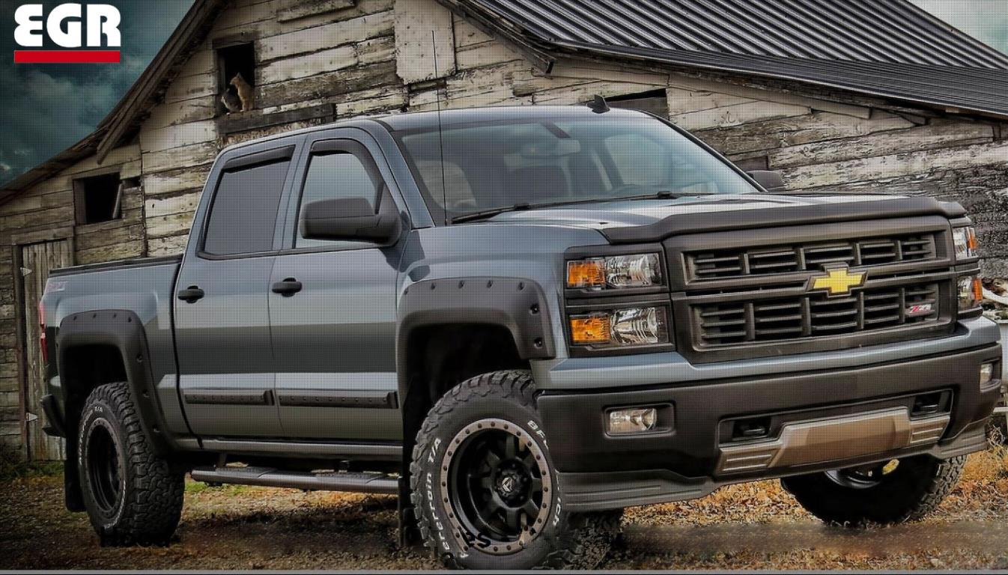
General Product Categories
Egr has a wide range of products for customizing your vehicle
Hood Deflectors
Window Deflectors
Fender Flares
Body Side Moldings
More to come…

Slide 4
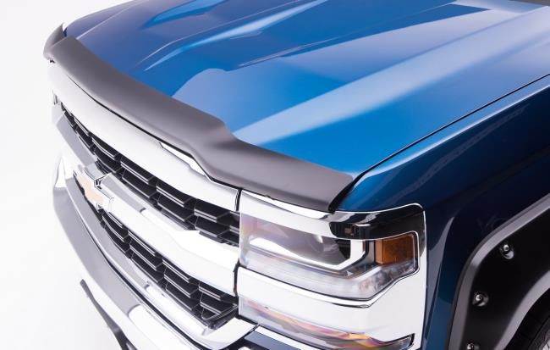
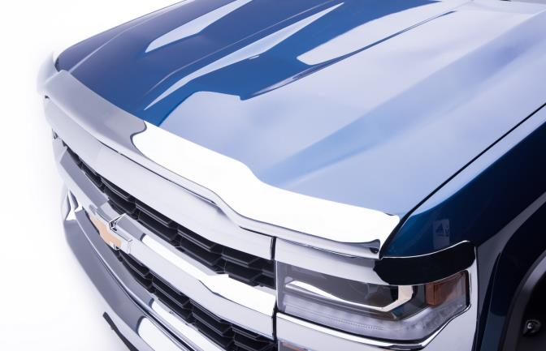
Hood Deflectors
  3 Distinct Styles of Hood Deflectors to choose from
  Smoke Black – Opaque smoked acrylic material
  Matte Black – Unique finish on top of acrylic material for a stylish look
  Chrome – ABS plastic material that has a chrome finish

Slide 5
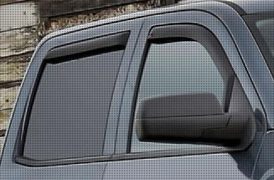
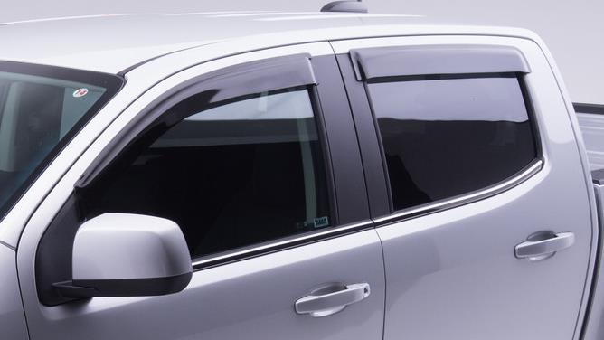
Side Window Deflectors
  2 Styles of Side Window Deflectors
  In-Channel Deflectors and Tape-On Deflectors
  In-Channel is held in by tension throughout the window sill and small barbs that are molded into the parts to help grip into the weather stripping.
  Tape-On Deflectors are the most widely known, however they are starting to be overtaken in the volume of sales of In-Channel deflectors.
  Available in Smoked Acrylic and Matte Black for most applications

Slide 6
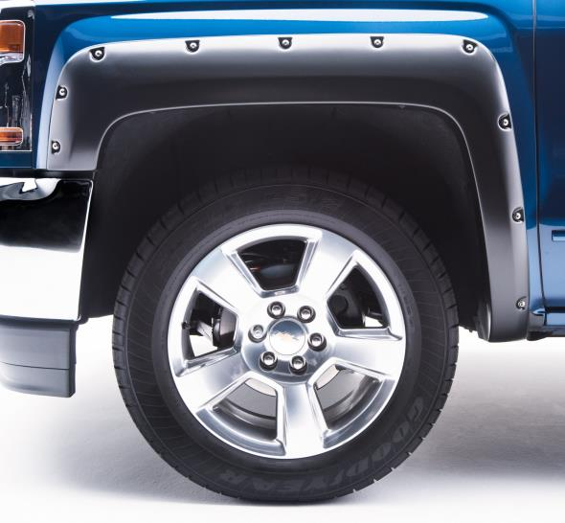
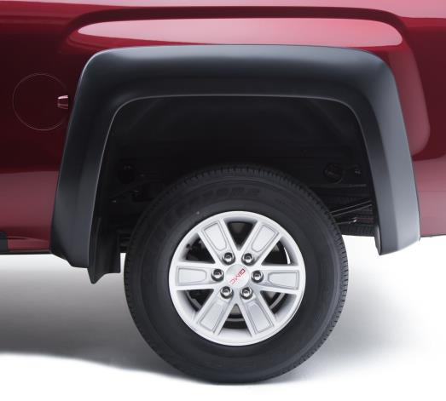
Fender Flares
  Another unique accessory to help customize a truck is the EGR Fender Flare Products
  Available in 2 different styles
  Rugged
  Bolt-On
  We pride ourselves in utilizing already existing mounting holes and existing hardware. All Fender Flares are no drill applications.
  Fender Flares are made out of 100% UV Stable Black ABS, and can also be painted to match the color of the truck fresh out of the box for the fully customized look of the vehicle.

Slide 7
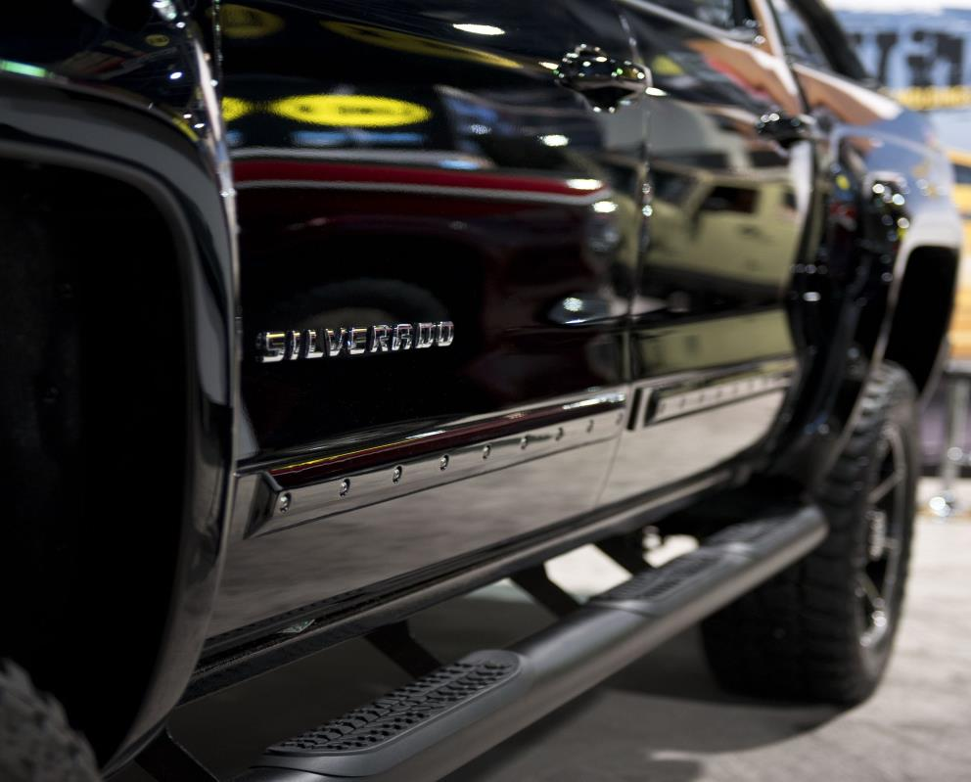
Body Side Moldings
  Another unique accessory to help customize a truck is the EGR Body Side Moldings
  Available in 2 different styles
  Rugged
  Bolt-On
  Injection Molded Polyurethane to give your vehicle added protection against door dings and dents.
  Body Side Moldings are also 100% UV Stable material, and can also be painted to match.
  Makes a great pairing with the same style Fender Flare

Slide 8
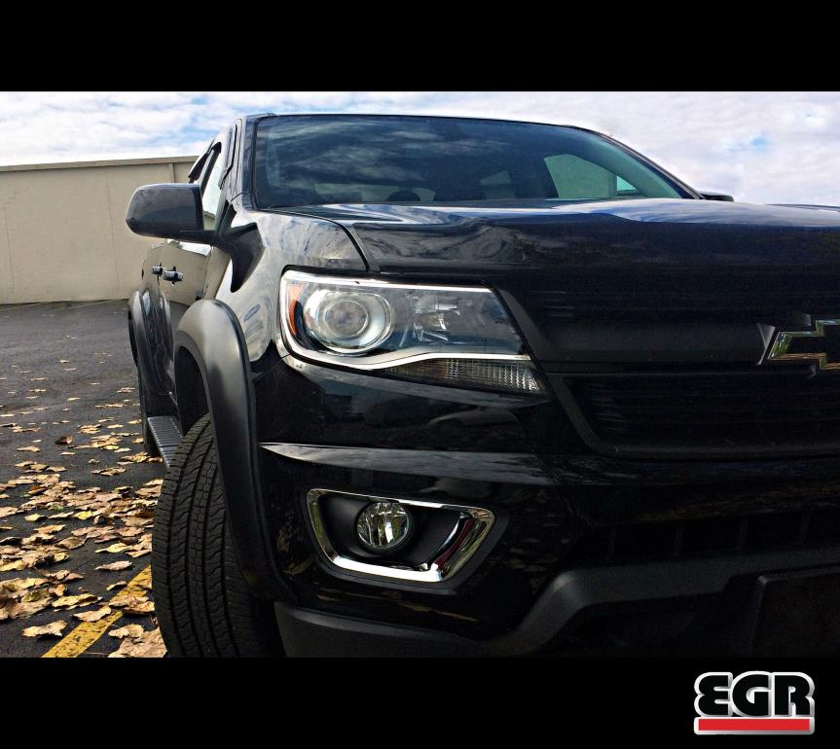
Installation Videos
  With the variety of products that we produce, we have been getting a lot of questions about the possibility of creating ‘How To’ videos.
  We have been working on creating generic and vehicle specific installation videos which you can find on our YouTube Channel
  YouTube - EGRAutomotiveUSA
  EGR California - 800 757 7075
  EGR Detroit – 248 848 1411

Slide 9
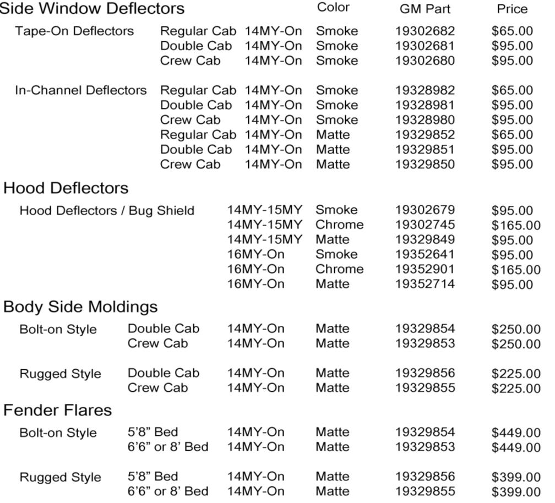
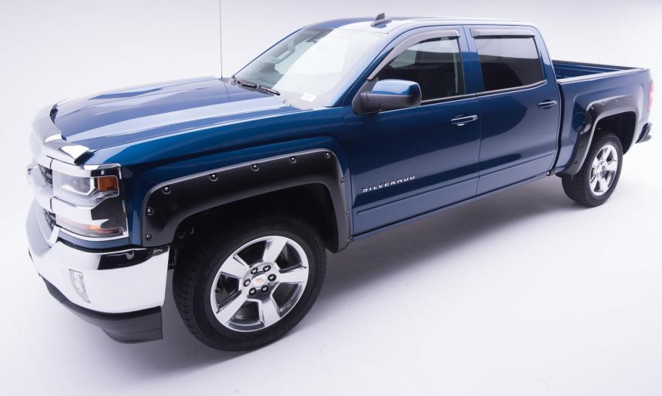
LD Silverado Product Offerings

Slide 10
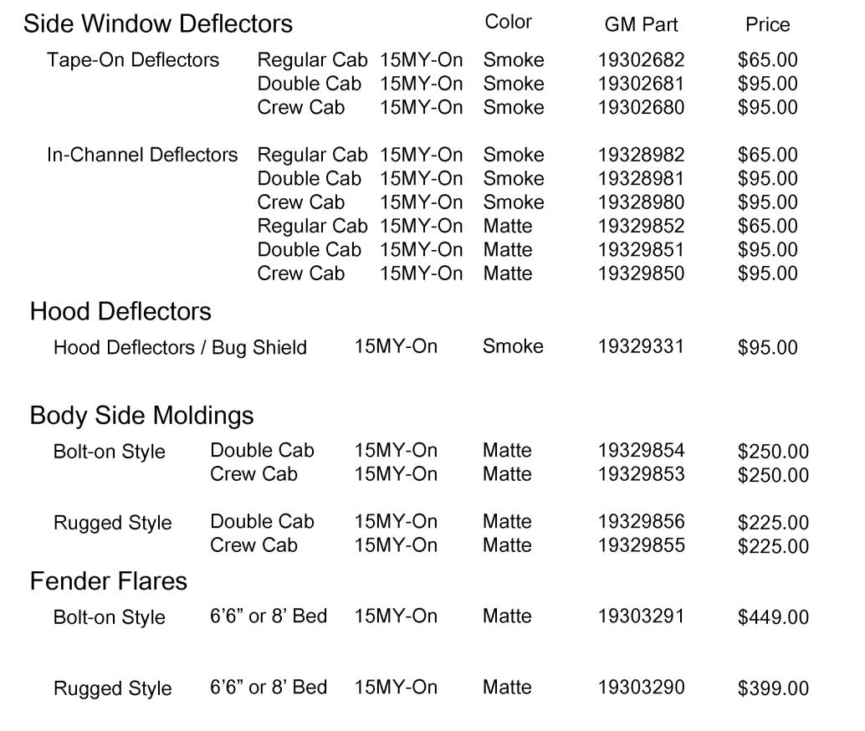
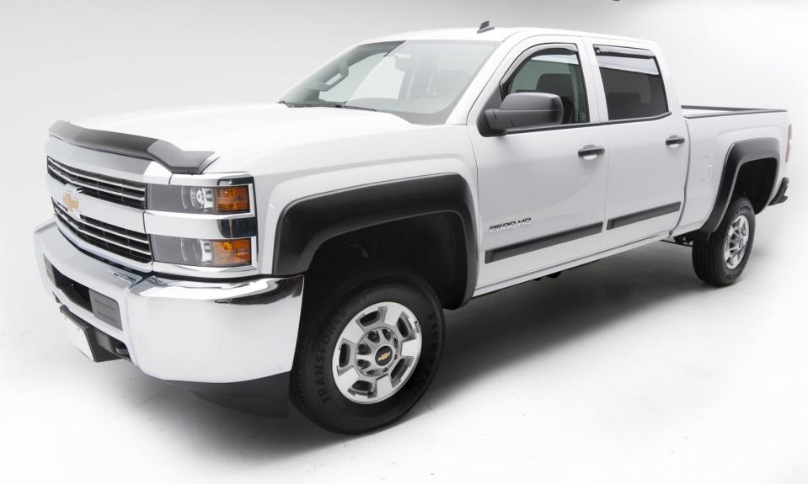
HD Silverado Product Offerings

Slide 11
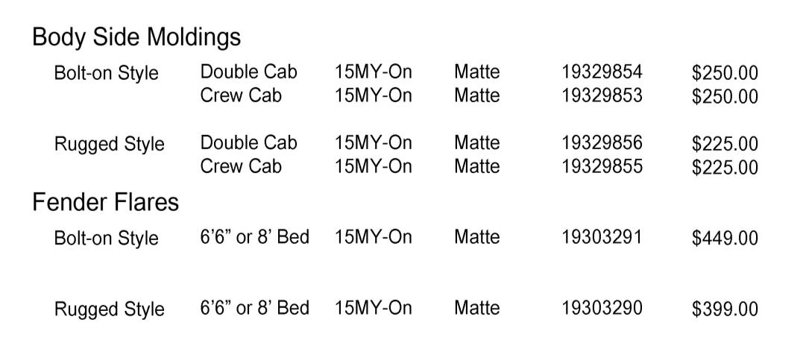
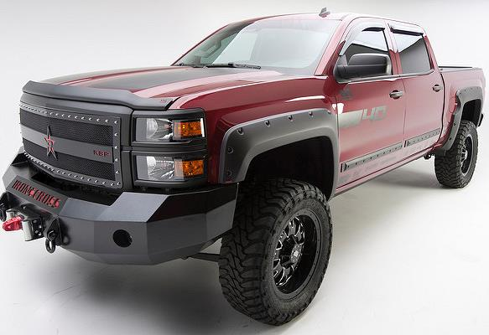
Sierra LD/HD Product Offerings

Slide 12
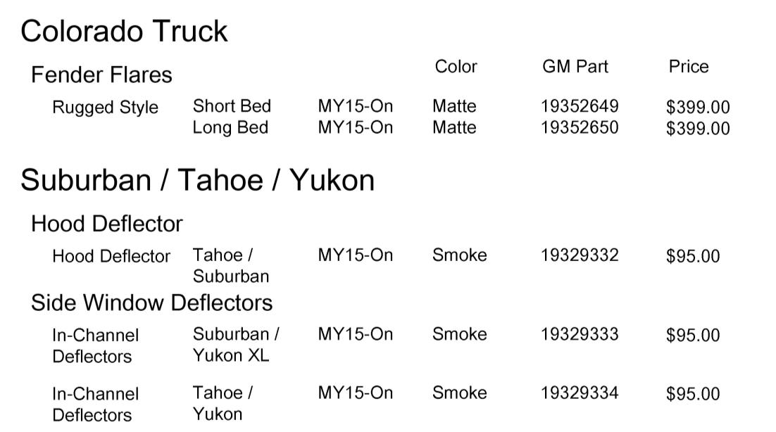
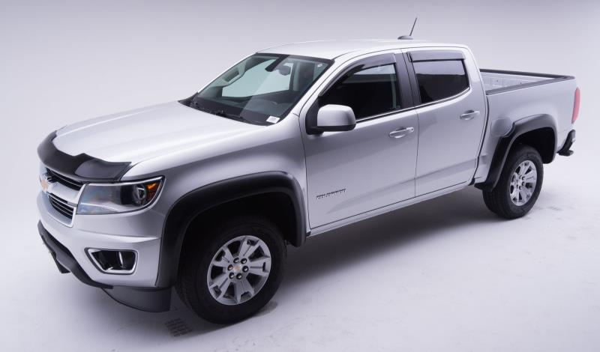
Colorado – Suburban – Tahoe - Yukon

Slide 13
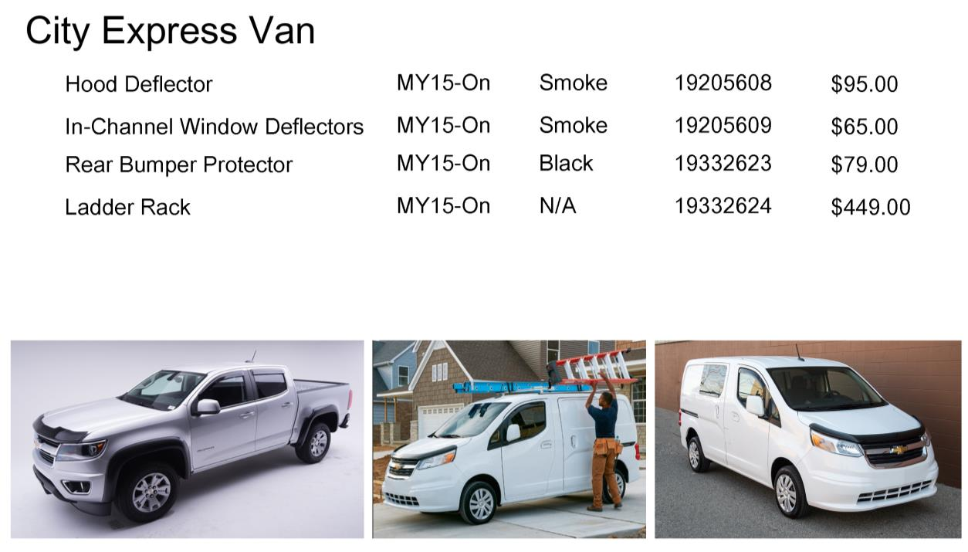
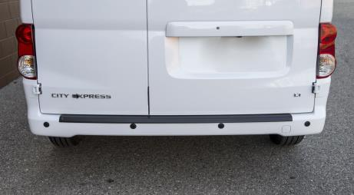
City Express Van Product Offerings

Slide 14

Warranty or Questions
  If at any time there is a question about our product, our warranty, or installation; please feel free to reach out to myself or our California facility at
  EGR California - 800 757 7075
  EGR Detroit – 248 848 1411
  Ken Jacoby – 248 878 6164

Slide 15

General Motors
ADI Presentation
2017

Slide 16
Opportunity is knocking…..
The good news- GM ADIs/dealers are doing really well with bed covers and bed accessories!
The better news- over 50% of truck buyers say they want a bed cover. On 5.8’ (Crew Cab ) trucks that percentage goes up to 76% when presented with today’s options! What is the percentage you are getting?
GM has developed a first class program……
Genuine products utilize the powerful Chevy and GMC brand!
IBP brings you quicker to market solutions to keep your dealers buying from you!
The proof is in the numbers-
GM purchases from Truck Hero have doubled in the last three years
There has never been a better time to be in the truck bed accessories business – make sure your dealers are getting their share!

Slide 17
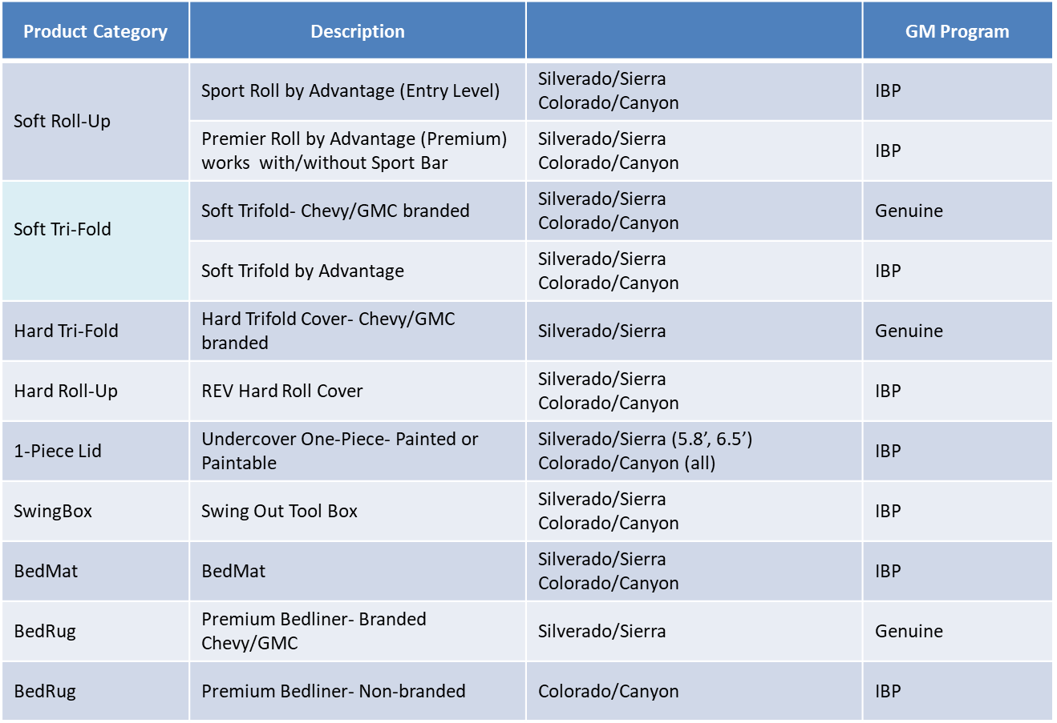
Truck Hero Current GM Programs

Slide 18
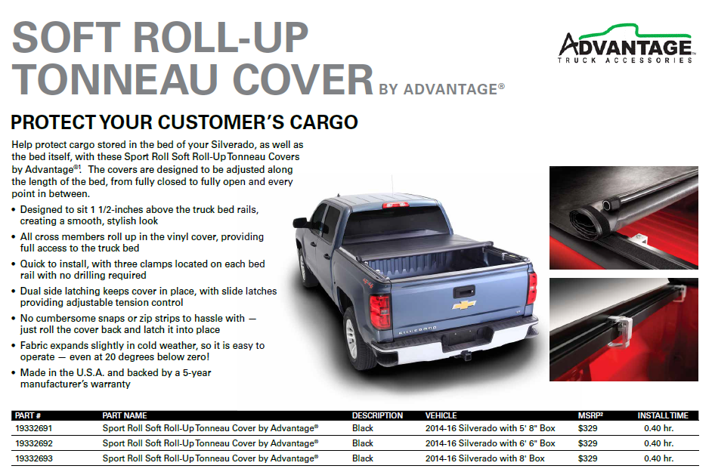
Great for Lease vehicles and Business Choice
PRICE LEADER $150 lease residual

Slide 19
The Premier Soft Roll-Up Tonneau Cover
features ONE-PERSON CARGO BED ACCESS
and quick dealership installation:
Smooth, stylish looks
Industrial grade, leather grained vinyl
Weather-resistant design
Easy, one-hand operation
Auto tension control
Works with or without Sport Bar!!!
Works w/without Sport Bar
$150 lease residual

Slide 20
Superior feature and benefits
competitive pricing
Great for Lease and BC
$150 lease residual PRICE LEADER

Slide 21
Priced hundreds below
other hard rolling covers
Easy install
Fastest growing $300 lease residual

Slide 22
$450. Lease residual

Slide 23
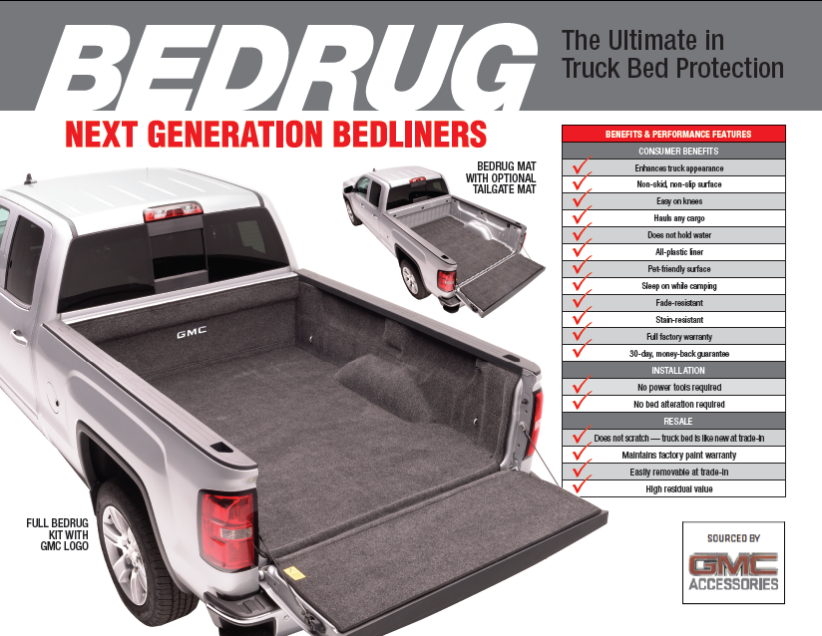
Available in IBP for Colorado/Canyon

Slide 24
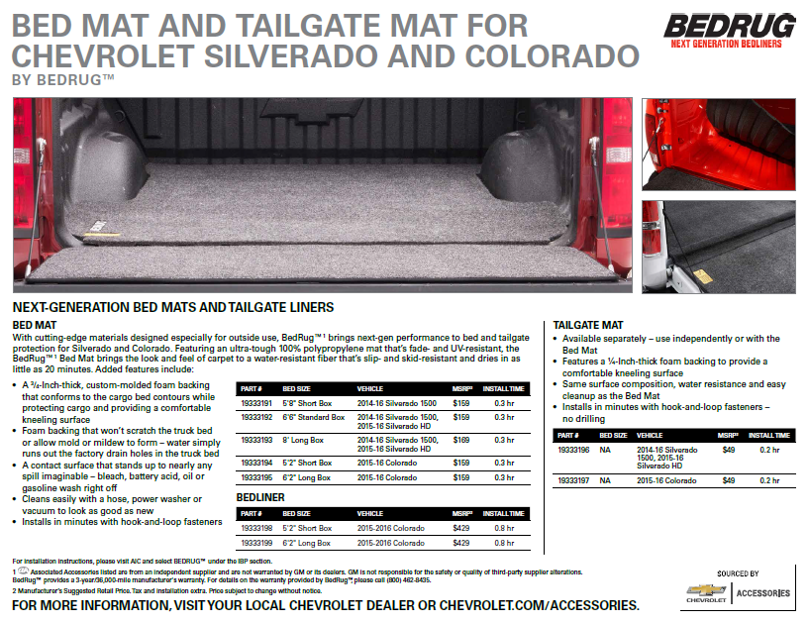
Perfect for trucks with spray in

Slide 25
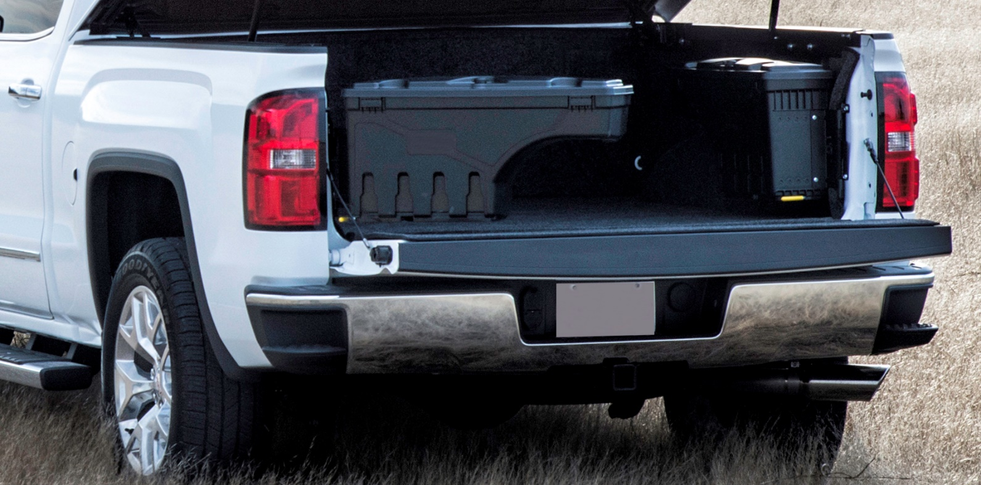
Great for Showroom Displaying
Driver or Passenger side

Slide 26
Talk numbers Mr. GM do you know that 52% of truck buyers are looking to cover the bed of their truck ?
The average gross profit on a truck bed cover is $200, how many trucks did you sell last month ?
Do you know vehicles in showroom with accessories sell faster than non accessorized vehicles ?
Dealerships that feature two or more trucks with bed covers increase penetration 3 fold .
Track you success’, Do you know the last vehicle we up- fitted brought an extra $400 gross profit to your dealership ?
Tee it up…walk the lot, know your dealerships’ clientele, know the dealerships needs (trucks without bedliners, cars without splash guards, etc.)

Slide 27
VP OEM Sales and Special Markets
Jeff Fink
20870 N River Ridge Dr
Bristol, IN 46507
Mobile: (574) 361-0267
Email: Jeff.Fink@truck-hero.com
Eastern Region
Senior OEM Field Sales Manager
Rick Davis
124 Coates Ave
New Castle, PA 16101
Mobile (724) 698-3610
Email: rick.davis@truck-hero.com
Western Region
OEM Field Sales Manager
Justin Locke
184 Depot Ln
Holland, MI 49424
Mobile: (989) 317-6316
Email: Justin.locke@truck-hero.com

